Slide 1


Visveswaraya Technological University SRI VENKATESHWARA COLLEGE OF ENGINEERING NH7, Vidyanagar, Kempegowda International Airport Road, Bengaluru -562157 DEPARTMENT OF ELECTRONICS & COMMUNICATION ENGINEERING (Accredited By NBA)
PRESENTATION ON
“AN INNOVATIVE SMART PLATFORM ASSIST IN DOMESTIC RAILWAY STATION”
Presented by,
NAVYASHREE H A (1VE16EC066)
Dept. of E&CE
SVCE, Bengaluru

Slide 2
CONTENTS
ABSTRACT
INTRODUCTION
LITERATURE SURVEY
OBJECTIVES
METHODOLOGY
COMPONENTS IDENTIFIED
WORK CARRIED OUT
RESULTS SO FAR
SOCIETY AND ENVIRONMENT RELEVANCE
ROAD MAP OF PROGRESS
CONCLUSION
REFERENCES

Slide 3
ABSTRACT
Now- a- days India is moving in a smarter direction by promoting the smart cities and smart railway stations, in this aspect we have taken a small initiative by adding an innovation in domestic railway platform in the Indian railway structure.
The motivation for this innovation is to address few problems faced by physically challenged people and senior nationals in crossing of foot over bridge between the two railway Platforms. To overcome this issue, a modified smart platform is proposed using machine learning algorithm.
The smart Platform is participated amidst the railway tracks in the side of the crossing point Platform. At the moment that there is no train arriving in the station, the smart Platform will be opened. The physically challenged individuals will use the smart Platform to cross between the Platforms.
The proposed structure gives the best response for the movement of physically challenged individuals from one platform to another Platform without using foot over bridge.

Slide 4
INTRODUCTION
Railway system is the most dependent transportation medium in our country. Thousands of people daily depend on railway transportation.
The Indian railway system lack in providing facilities to the handicapped and elderly aged people who are unable to climb the stairs.
For this category of people it is difficult to take the foot over bridge and reach the other platform especially during peak and emergency situations.
This project focuses on incorporating smart railway platform at our railway stations.
The smart railway platform which is integrated between two tracks helps the passengers to cross the platforms by creating a virtual platform.

Slide 5
LITERATURE SURVEY
Sl.no | Paper Details | Contribution | Drawbacks
[1]. | “Automated mobile platform for physically challenged people in railway junction”, Dr .P. Gomathi, Dinesh.,International Journal of Advanced Engineering Technology E-ISSN 09763945 Int J Adv Engg Tech/Vol. VII/Issue II/April-June, 2017/559-562. | They programmed mobile platform to old aged people. Voice declaration and escalators are provided. | They have used IR sensors to detect train motion. IR sensors are very agile, and proves inaccurate. AVR studio requires an IDE and programming skills.
[2]. | “Smart railway crossing embedded with automated platform bridge”, Prashantha B, Harisha S, issue on August 2016 by IJRET in 2321-730. Engineering and Technology eISSN: 2319-1163. | To Provide automatic level crossing. Implemented automated flat form bridge. | They have used read sensors to detect train motion. Even these are very agile in finding the train approach much affectively
[3]. | “Mobility Platform for Physically Challenged People using Wireless Sensor Network”, Vidhya.K, Aarthy. A, International Journal of Engineering & Technology, [S.l.], v. 7, n. 2.24, p. 255-258, apr. 2019. ISSN 2227-524X. | Automatic railway bridge to move from one platform to another. Voice declaration for arrival of train is provided. | They have used PIR sensor which is easily interfered by heat sources. Inaccuracy

Slide 6
Continued…
Sl.no | Paper Details | Contribution | Drawbacks
[4]. | “Artificial railway platform for domestic railway station” Sudarsan .P, Ram Kumar. S, Surendar.R, UdaySankar.T, Karthik proceedings of 21st IRF International Conference, 15th March 2016, Chennai, India, ISBN: 978-93-82702-78-8. | To automate railway track pedestrian crossing without use of staircase. Announcement of status of train arrival for platform users are provided. | Sensed signals are sent to PIC Microcontroller. Due to RISC architecture in PIC, the length of the program is high. Program memory is not accessible.
[5]. | “Face Recognition based on Convolution Neural Network” Kewen Yan, Shaohui Huang, Yaoxian Song, Wei Liu, Neng Fan. Proceedings of the 36th Chinese Control Conference, July 26-28, 2019, Dalian, China. | They have used nine convolution neural network for face recognition. Ubuntu operating system is used as the experimental environment. | The recognition rate is poor with face database and IR database. Little hardware support for Ubuntu OS.
[6]. | “Modelling of Track layout for intelligent railway signalling system: A machine learning application” Y.Baviskar, U.Suryawanshi, A.Sheikh EEED,Aug-29-2019, VJIT, Mumbai, India. | Development of an automated track model , beneficial to Intelligent Signalling system. IR standard single line station layout is considered and graphical based techniques are implied. | Construction of ISS is a complicated task that cannot be achieved overnight and should be implemented step-by-step.

Slide 7
OBJECTIVES
To help the physically challenged people to cross the intersection of platforms.
To minimize the chances of accidents at railway stations.
To incorporate advanced technical paradigms at present day Railway stations.
To design a smart and an automatic pedestrian crossing bridge.
To alert the passengers by using the alert signals on the railway platforms.

Slide 8
METHODOLOGY
Proximity sensor/camera is used to detect the metal product. In our task we utilize this sensor to distinguish the position of the train.
We utilize two sensors for security reason to maintain a strategic distance from mechanical issue. The sensor gives two outputs.
In the event when train draws close to smart platform, the proximity sensor/camera with the machine learning algorithm detects the train position and gives its yield.
Processor triggers the motor unit eventually enables or disables the virtual platform based on the input data from the sensor/camera unit.

Slide 9
Continued…
Distributed Neural network for processing Image data set.
Predefined Images stored in the database.
Classifier algorithms conclude the type of image.
Based on this learning mechanism, processor triggers the motor.
Figure 1 depicts project schematic diagram and figure 2 depicts the functional flow diagram.

Slide 10
SMART RAILWAY PLATFORM SCHEMATIC
POWER
SUPPLY
MOTOR
PROXIMITY SENSOR/
CAMERA UNIT
PLATFORM
RAILWAY TRACK
PLATFORM
SMART PLATFORM
SMART PLATFORM
RAILWAY TRACK
CONTROL UNIT
PROXIMITY SENSOR/ CAMERA UNIT
MOTOR
Figure 1: Block Diagram Of Smart Railway Platform

Slide 11
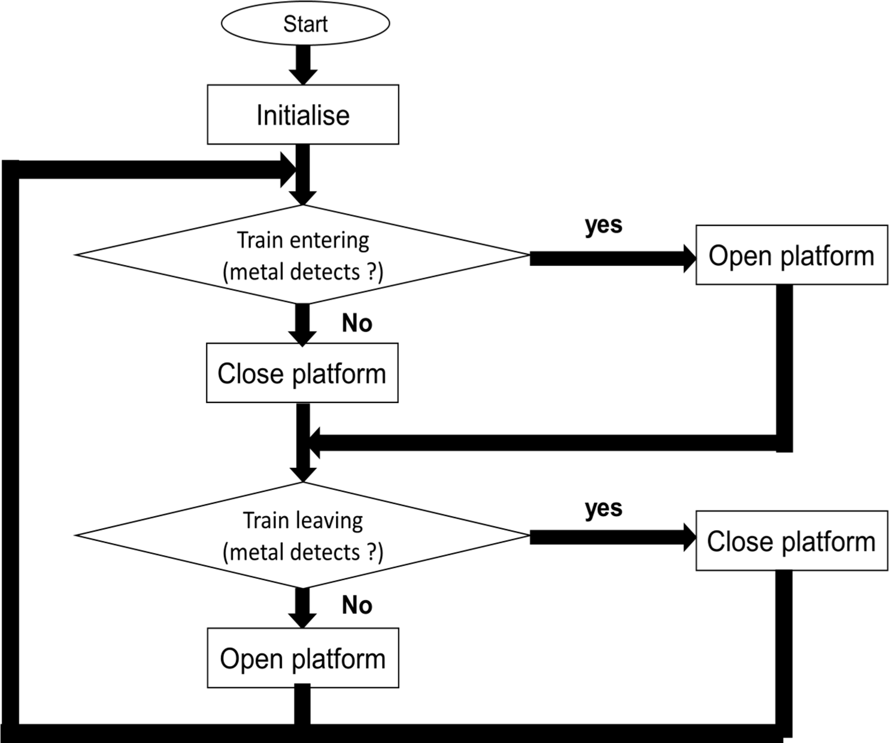
Figure 2: Flow Chart of Automated Smart Railway Platform

Slide 12
Start
Initialize the pi cam
Captures the image (when the proximity sensor triggers the pi cam)
Compare the captured image with predefined database (using CNN algorithm)
Classifies whether the captured image is of train or not (using Haar Cascade classifier)
If captured image is train
NO
YES
Raspberry pi triggers the DC motor
Hence the DC motor rotates the virtual platform to angle of 90º
Figure 3: Flow diagram of Train Detection

Slide 13
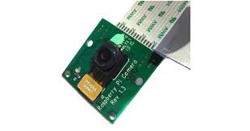
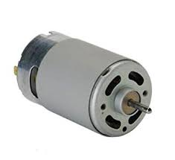
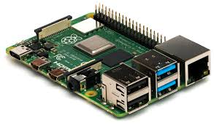
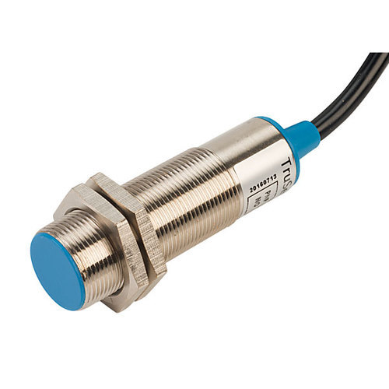
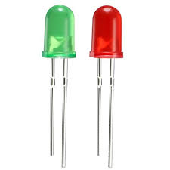
COMPONENTS REQUIRED
DC motor
Pi camera
Raspberry Pi
Proximity sensor
Figure 4: Hardware components
Led

Slide 14
COMPONENTS DISCRIPTION
RASPBERRY PI
The Raspberry pi is a single computer board with credit card size, that can be used for many tasks that your computer does, like games, word processing, spreadsheets and also to play HD video. It was established by the Raspberry pi foundation from the UK. It is the advanced form of microcontroller. It operates in the same way as a standard PC, requiring a keyboard for command entry, a display unit, and a power supply. The raspberry pi board is portable and low cost. The Raspberry Pi is shown in Fig.5.
Figure 5: Raspberry Pi

Slide 15
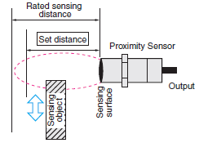
PROXIMITY SENSOR
A proximity sensor is able to detect the presence of nearby objects without any physical contact. It often transmits an electromagnetic field or a light emission radiation(for example, infrared), and searches for changes in the field or return signal. Proximity sensors can have a high reliability and long functional life because of the absence of mechanical parts and lack of physical contact between the sensor and the sensed object. Fig.6 shows the function of proximity sensor.
Figure 6: Proximity Sensor

Slide 16

DC MOTOR
A DC motor is any of a class of rotary electrical motors that converts direct current electrical energy into mechanical energy. The most common types relay on the forces produced by magnetic fields. The DC motor achieves this by producing a continuous angular rotation that can be used to rotate pumps, wheels, etc. It consists of inductors inside, which produce magnetic field used to generate movement. DC motor is shown in Fig.7.
Figure 7: DC Motor

Slide 17
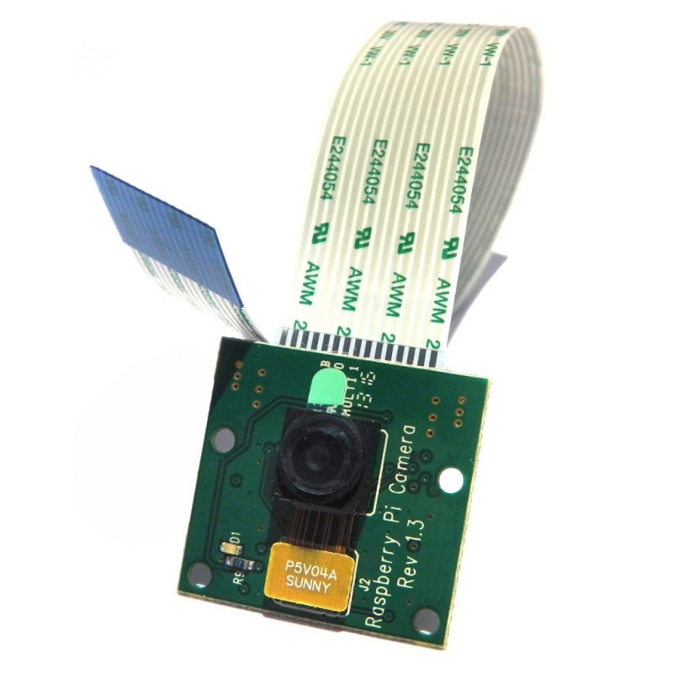
CAMERA UNIT
The Pi camera module is a portable light weight camera that supports Raspberry Pi. It communicates with Pi using the MIPI camera serial interface protocol. It is normally used in image processing, machine learning or in surveillance projects. The Raspberry Pi Camera Board plugs directly into the CSI connector on the Raspberry Pi. It's able to deliver a crystal clear 5MP resolution image, or 1080p HD video recording at 30fps. The Raspberry Pi camera board is shown in Fig.8.
Figure 8: Pi Camera Board

Slide 18
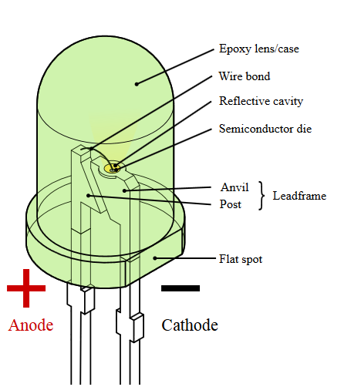
LED
A light-emitting diode (LED) is a semiconductor light source that emits light when current flows through it. Electrons in the semiconductor recombine with electron holes, releasing energy in the form of photons. The LED is a special type of diode and they have similar electrical characteristics of a PN junction diode. Hence the LED allows the flow of current in the forward direction and blocks the current in the reverse direction. The LED is shown in Fig.9.
Figure 9: LED

Slide 19
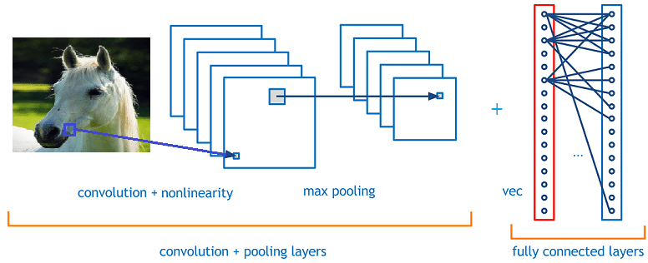
WORK CARRIED OUT
Figure 10: Convolution Neural Network Design

Slide 20

CNNs are a category of Neural Networks that have proven very effective in areas such as image recognition and classification. CNNs are a type of feed-forward neural networks made up of many layers.
CNNs consist of filters or kernels or neurons that have learnable weights or parameters and biases.
Each filter takes some inputs, performs convolution and optionally follows it with a non-linearity. A typical CNN architecture can be seen as shown in Fig.10.
The structure of CNN contains Convolutional, pooling, Rectified Linear Unit (ReLU), and Fully Connected layers.

Slide 21

Convolutional Layer:
Convolutional layer performs the core building block of a Convolutional Network that does most of the computational heavy lifting.
The primary purpose of Convolution layer is to extract features from the input data which is an image. The input image is convoluted by employing a set of learnable neurons.
Pooling Layer:
Pooling layer reduces the dimensionality of each activation map but continues to have the most important information. The input images are divided into a set of non-overlapping rectangles.
This layer achieves better generalization, faster convergence, robust to translation and distortion and is usually placed between convolutional layers.

Slide 22
ReLU Layer:
ReLU is a non-linear operation and includes units employing the rectifier. It is an element wise operation that means it is applied per pixel and reconstitutes all negative values in the feature map by zero.
Here, we assume that there is a neuron input given as x and from that the rectifier is defined as f(x)= max(0,x) in the literature for neural networks.
Fully Connected Layer:
Fully Connected Layer (FCL) term refers to that every filter in the previous layer is connected to every filter in the next layer. The output from the convolutional, pooling, and ReLU layers are embodiments of high-level features of the input image.
The goal of employing the FCL is to employ these features for classifying the input image into various classes based on the training dataset. This is ensured by using the Softmax as the activation function.

Slide 23
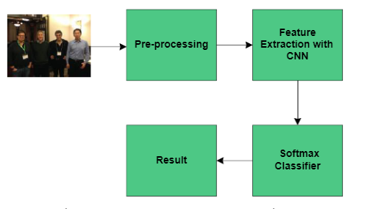
The block diagram of the proposed CNN recognition algorithm is shown in Fig.11. The algorithm is mainly carried out in three steps as below: 1. Resize the input images as 16x16x1, 16x16x3, 32x32x1, 32x32x3, 64x64x1, and 64x64x1. 2. Build a CNN structure with eight layers made up of convolution, max pooling, convolution, max pooling, convolution, max pooling, convolution, and convolution layers respectively. 3. After extracting all features, use Softmax classifier for classification.
Figure 11: Block diagram of CNN algorithm

Slide 24
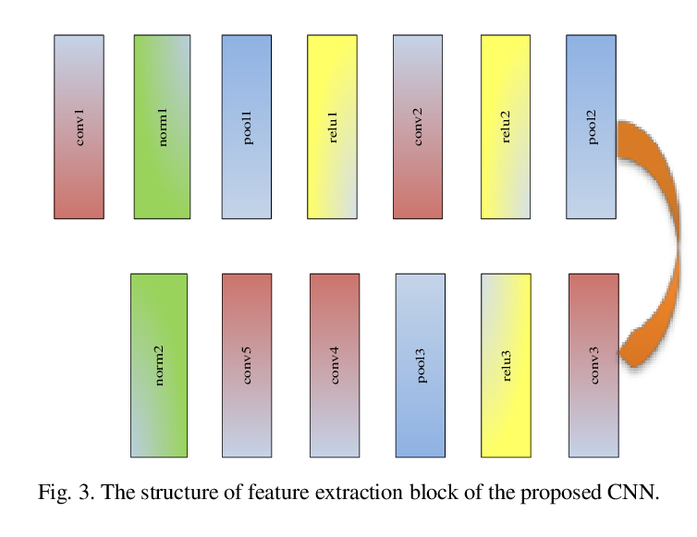
The structure of feature extraction block is as shown in Fig.12.,
Figure 12: The structure of feature extraction of the CNN

Slide 25
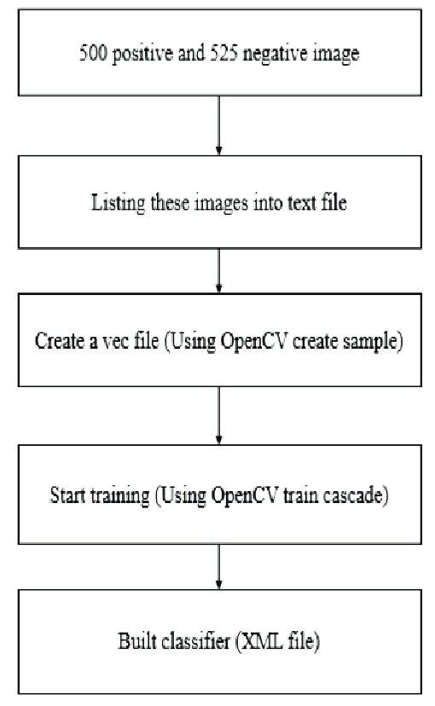
HAAR CASCADE CLASSIFIER
A Haar Cascade is based on “Haar Wavelets”. Haar Cascades is a machine learning techniques in which a function is trained from a lot of positive and negative images. A sequence of rescaled “square-shaped” functions which together form a wavelet family or basis. It is based on the Haar wavelet technique to analyze pixels in the image into squares by function. The training procedure is shown in fig.13.
Figure 13: Training procedure of classifier

Slide 26
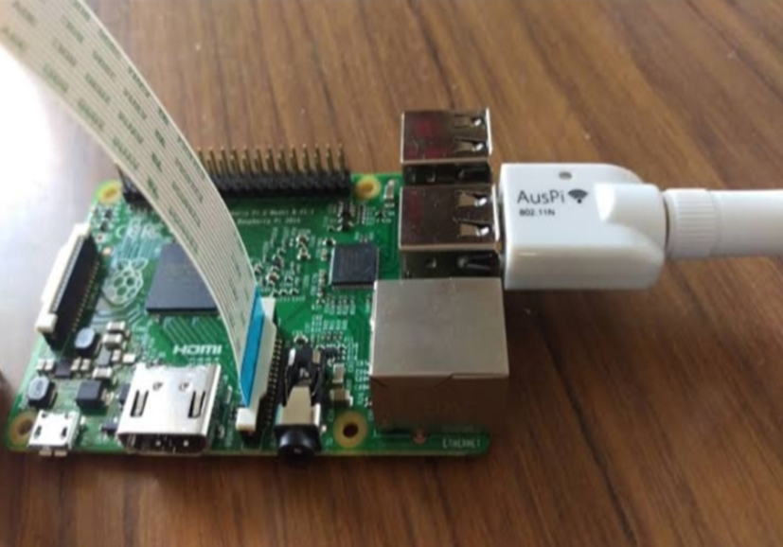
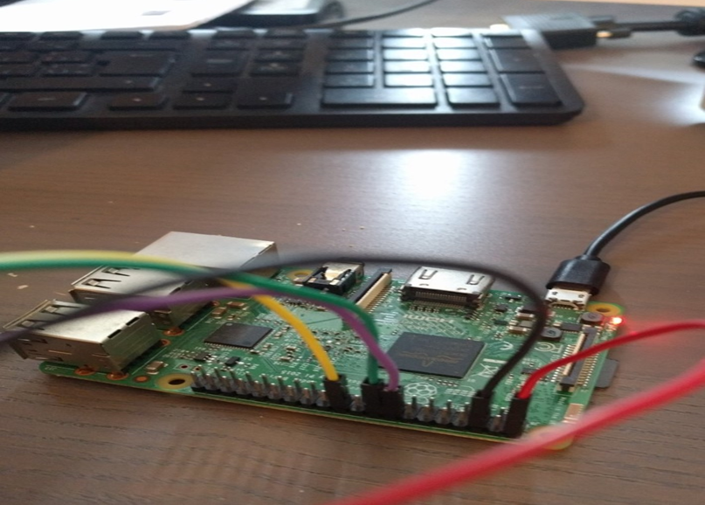
HARDWARE CONNECTIONS
Figure 14: Pi Camera Interfaced With Raspberry Pi

Slide 27

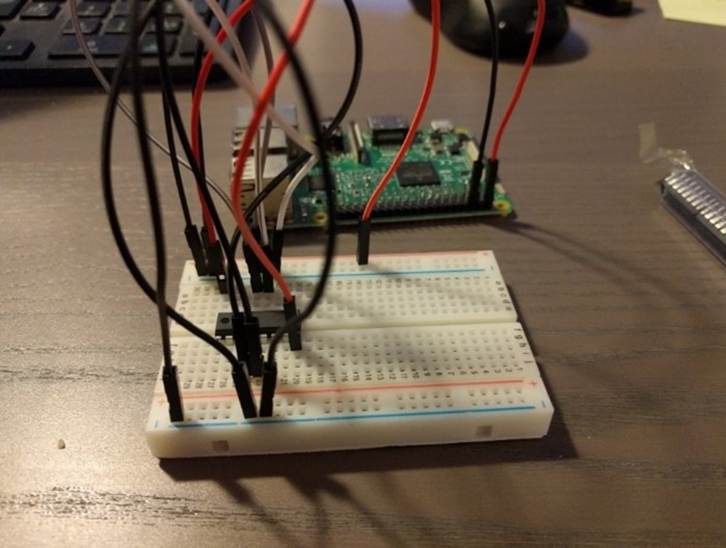
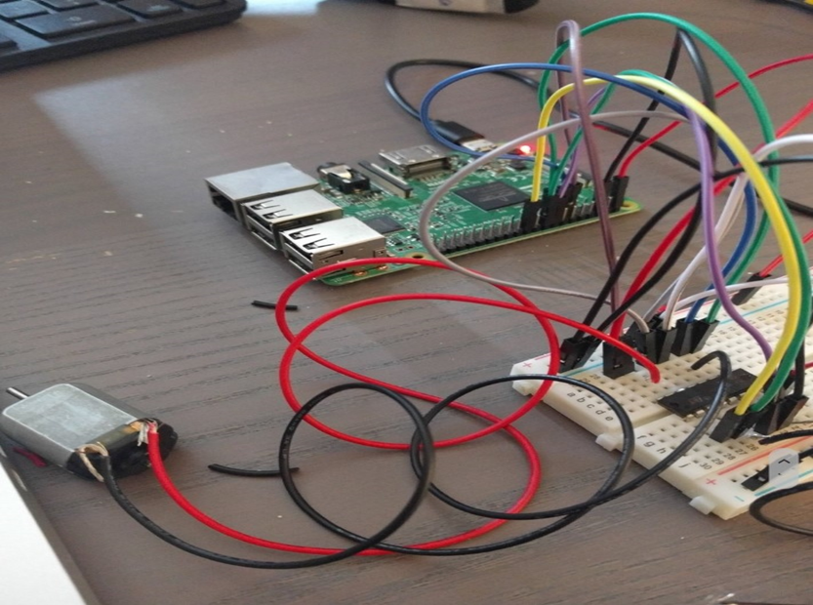
Figure 15: Raspberry Pi Interfaced With DC Motor

Slide 28
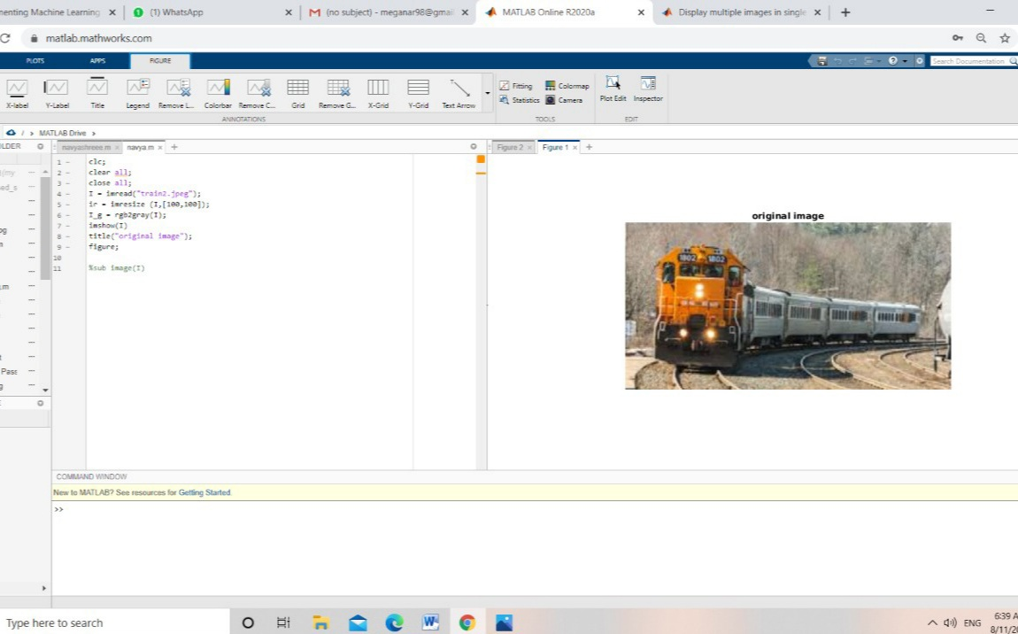
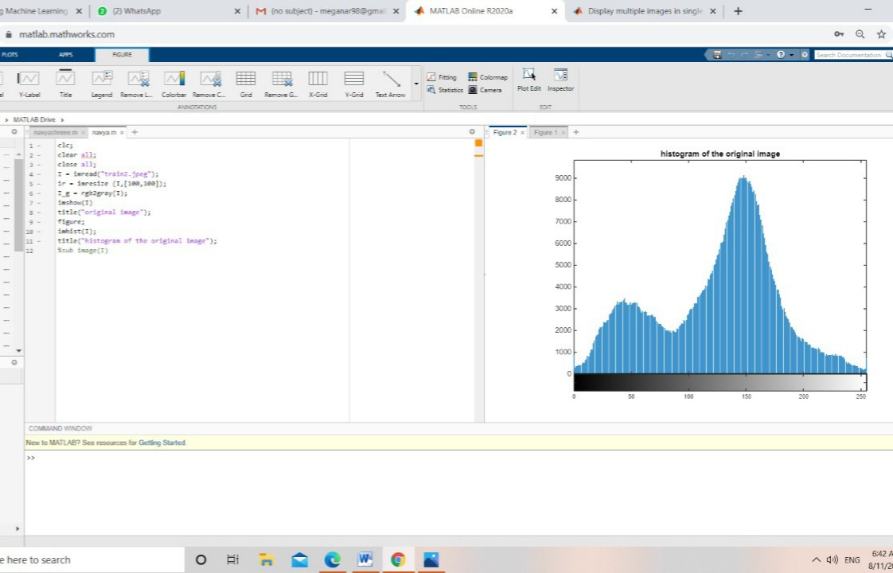
RESULTS
Convolution neural network is a method that is used to describe characteristics of the image. Applying this method, the texture characteristic probability of an input image can be summarized into histogram. The Figure 16, shows the captured image which is obtained by MATLAB code. The Figure 17, depicts the histogram of original image.
Figure 16: Output of original image
Figure 17: Histogram of original image

Slide 29
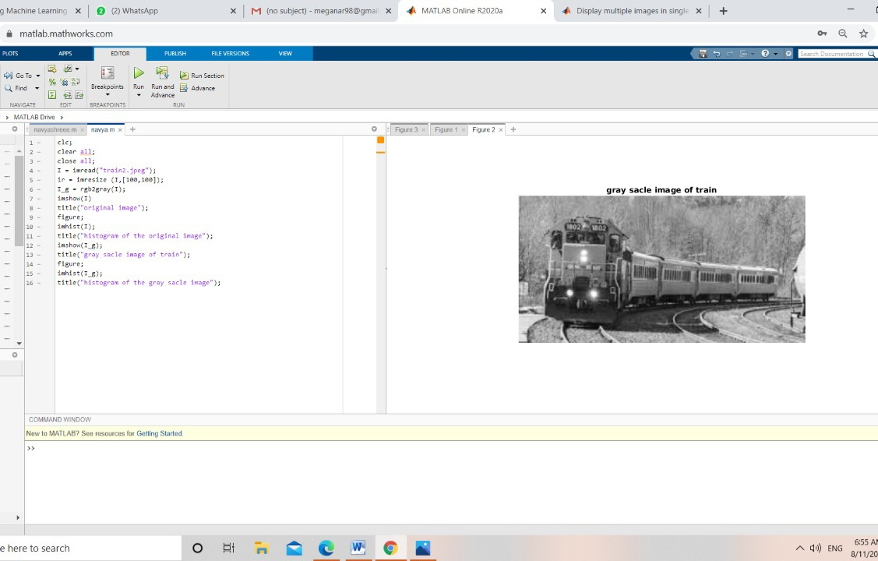
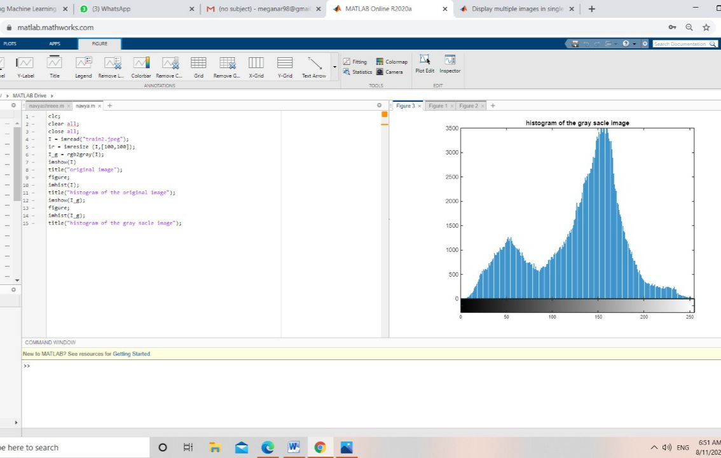
The Figure 18, shows the converted gray scale image of original color image using the MATLAB Code.The Figure 19, depicts the histogram of coverted gray scale image.
Figure 18: Output of gray scale image
Figure 19: Histogram of gray scale image

Slide 30
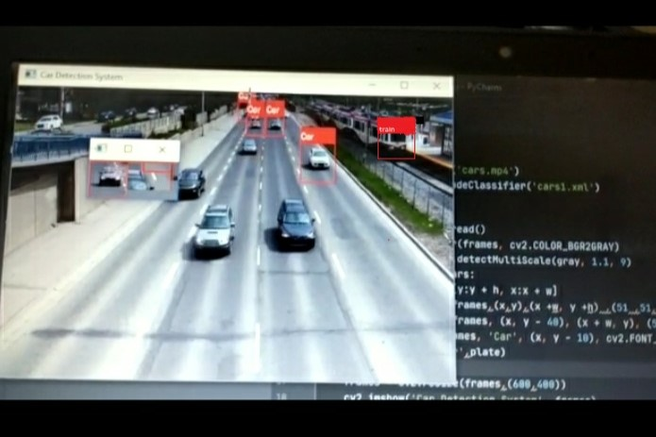
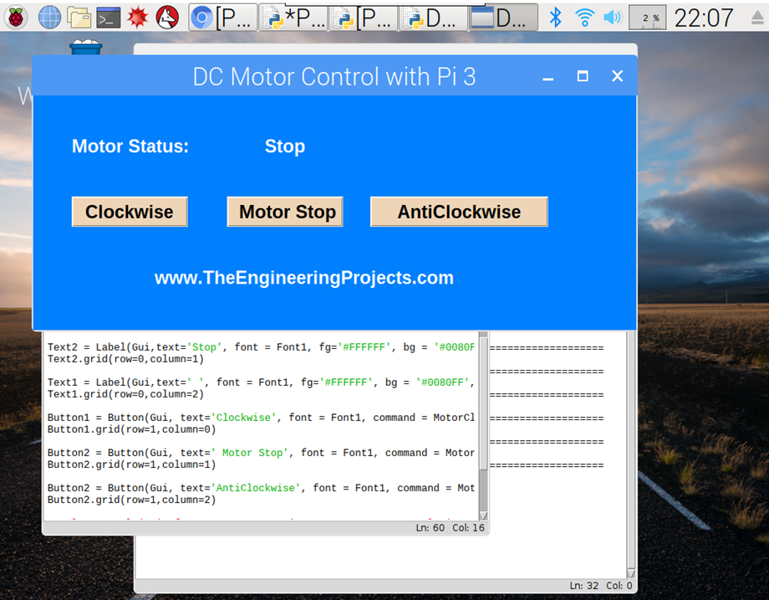
The captured images is shown in Figure 20, is been successfully detected and recognized. The rectangular box is obtained by the haar cascade classifier. Here in this image, the train is detected.The Figure 21, shows the output window of DC motor control.
Figure 20: The simulation output displayed on the screen
Figure 21: Output window of DC motor control

Slide 31
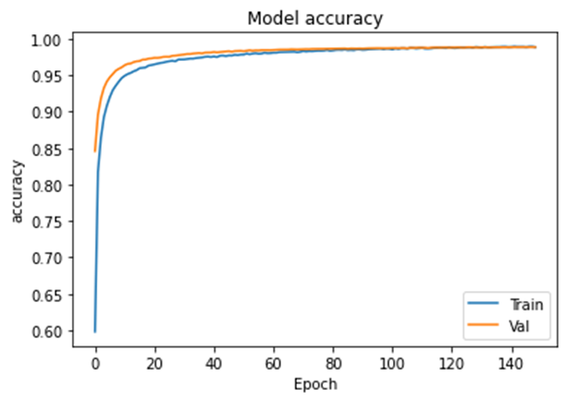
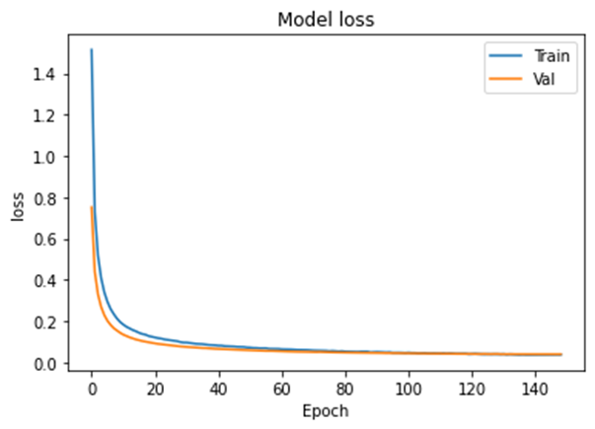
The Figure 22, shows the model accuracy for each epoch. The Figure 23, shows the model loss for each epoch.140 epochs took 3 minute 15 seconds, resulting the accuracy of 91.82% and loss of 0.027.
Figure 22: Plot of Model accuracy
Figure 23: Plot of Model loss

Slide 32
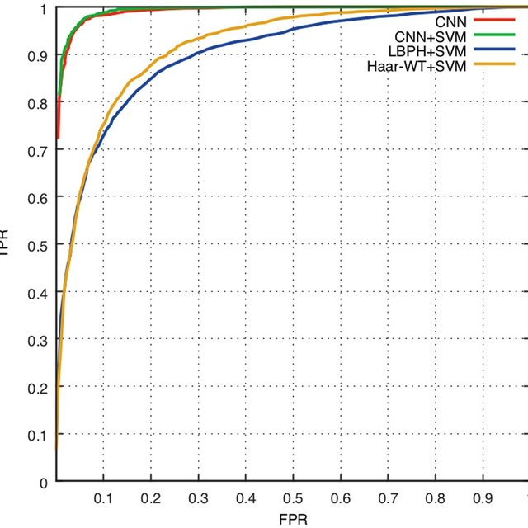
CNN is primarily used to obtain high-level features from raw images and the softmax is often used to classify and evaluate the accuracy. The graph shown in Figure 24, suggests that the features extracted using CNN are more discriminative than those extracted using LBPH and Haar-WT.
Figure 24: Plot of accuracy comparison among different algorithms.

Slide 33
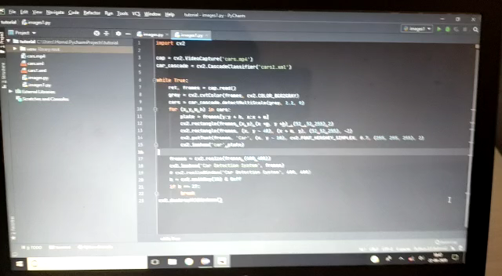

Slide 34
SOCIETY AND ENVIRONMENT RELEVANCE
Due to rapid increase in accidents happening at railways, there is a requirement for enhanced safety and security system.
The system proposed here results in infrastructural development at railways. Its cost effective and also more efficient.
This proposed system is not only limited to the infrastructural development at railways, but also results in secured virtual platform for physically challenged people.
As the proposed system is built by using some of the machine learning paradigms this enhances the system performance and gives fast response.
This system provides a better platform for old aged people and reduces the accidents taking place while crossing the platforms.

Slide 35


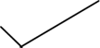


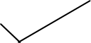
HARDWARE IMPLEMENTATION AND DESIGN
COMPONENTS IDENTIFICATION AND SOFTWARE IMPLEMENTATION
END
LITERATURE REVIEW AND METHODOLOGY
ROAD MAP OF OUR PROGRESS
START

Slide 36
CONCLUSION
The customized Smart Platform gives the splendid office to the physically challenged individuals in railway convergence to cross the Platforms without using foot over bridge with enhanced safety and security upon sensing the train consistently with the advanced technological logical paradigms consequently closes and opens the smart platform giving the exuberant experience to the current Indian railway system.

Slide 37
REFERENCES
[1]. Vidhya.K, Aarthy. A ” Mobility Platform for Physically Challenged People using Wireless Sensor Network.” International Journal of Engineering & Technology, [S.l.], v. 7, n. 2.24, p. 255-258, /9 2019. ISSN 2227-524X.
[2]. Kewen Yan, Shaohui Huang, Yaoxian Song, Wei Liu, Neng Fan. “Face Recognition based on Convolution Neural Network” proceedings of the 36th Chinese Control Conference, July 26-28, 2019, Dalian, China.
[3]. Y.Baviskar, U.Suryawanshi, A.Sheikh EEED “Modelling of Track layout for intelligent railway signalling system: A machine learning application” Aug-29-2019, VJIT, Mumbai, India.
[4]. Dr.P.Gomathi, Dinesh “Automated mobile platform for physically challenged people in railway junction”. International Journal of Advanced Engineering Technology E-ISSN 09763945 Int J Adv Engg Tech/Vol. VII/Issue II/April-June,2018/559-562.
[5]. Prashantha B, Harisha S “Smart railway crossing embedded with automated platform bridge” issue on August 2017 by IJRET in 2321-730.Engineering and Technology eISSN: 2319-1163.

Slide 38
Continued…
[6]. Akhila Mohan, Alex Albert, Alfa S S, Alphi Iodine “Platform Assisted Railway Crossing” Journal of Embedded Systems & Its Applications Volume 1 Issue 2.
[7]. Sudarsan .P, Ram Kumar. S, Surendar.R, UdaySankar.T, Karthik “Artificial railway platform for domestic railway station” proceedings of 21st IRF International Conference, 15th March 2017, Chennai, India, ISBN: 978-93-82702-78-8.
[8]. G.Prabhavathi, B.Sanjana, Ms.S.P.Dhivya “ Railway Track Pedestrian Crossing between Platforms” IOSR Journal of Electronics and Communication Engineering (IOSR-JECE) eISSN: 2278-2834,p- ISSN: 2278-8735.Volume 9, Issue 2, Ver. III (Mar - Apr. 2017).

Slide 39
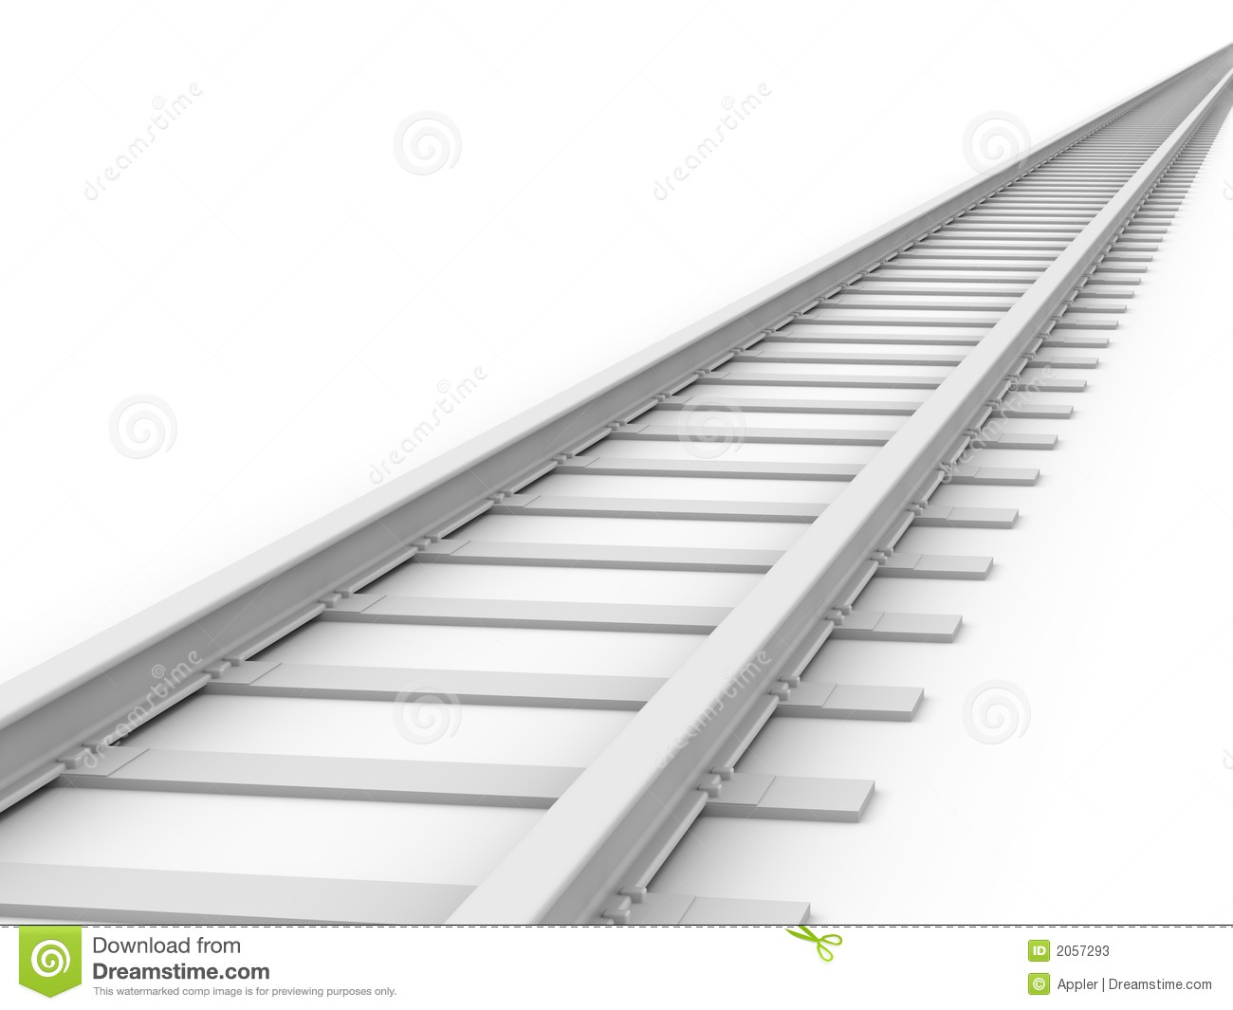
THANK YOU

Slide 40


